Slide 1

DATA VISUALIZATION
END COURSE PROJECT

Slide 2

UEFA CHAMPIONS LEAGUE 2021/22
For this Project, we’ll be having an Exploratory Data Analysis on the Champions League 2021/22 season.
We’ll enrich this dataset by looking at Quarter Finals since 1980.

Slide 3
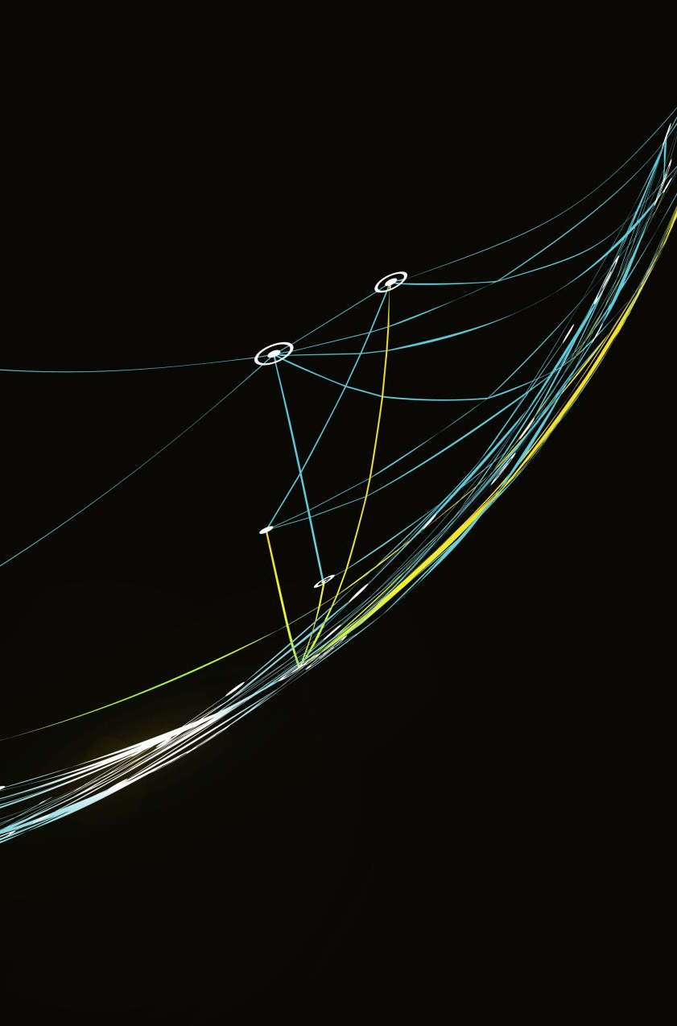
DATAFRAMES
Let’s dive in…

Slide 4
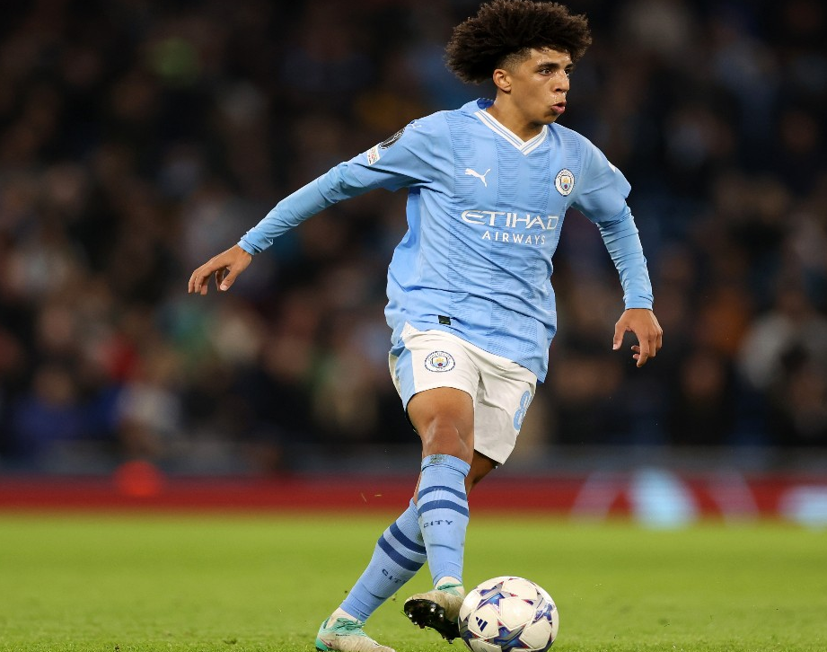
ATTACKING DATAFRAME
Attacking features and points for the UCL 21/22

Slide 5
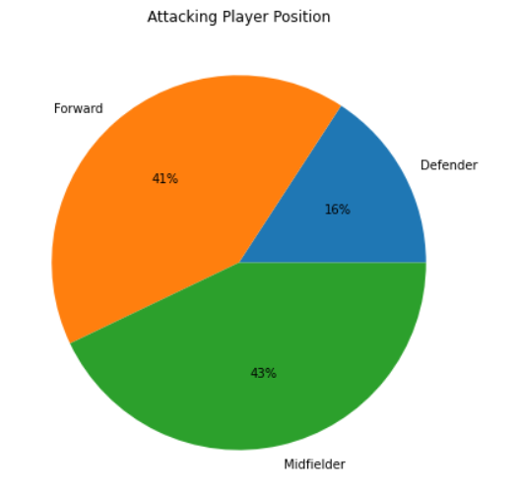
PLAYER ATTACKING POINTS
Player Position on Attacking Attributes
From our pie chart we see that midfielders appeared the most. This does not necessarily mean causation.

Slide 6
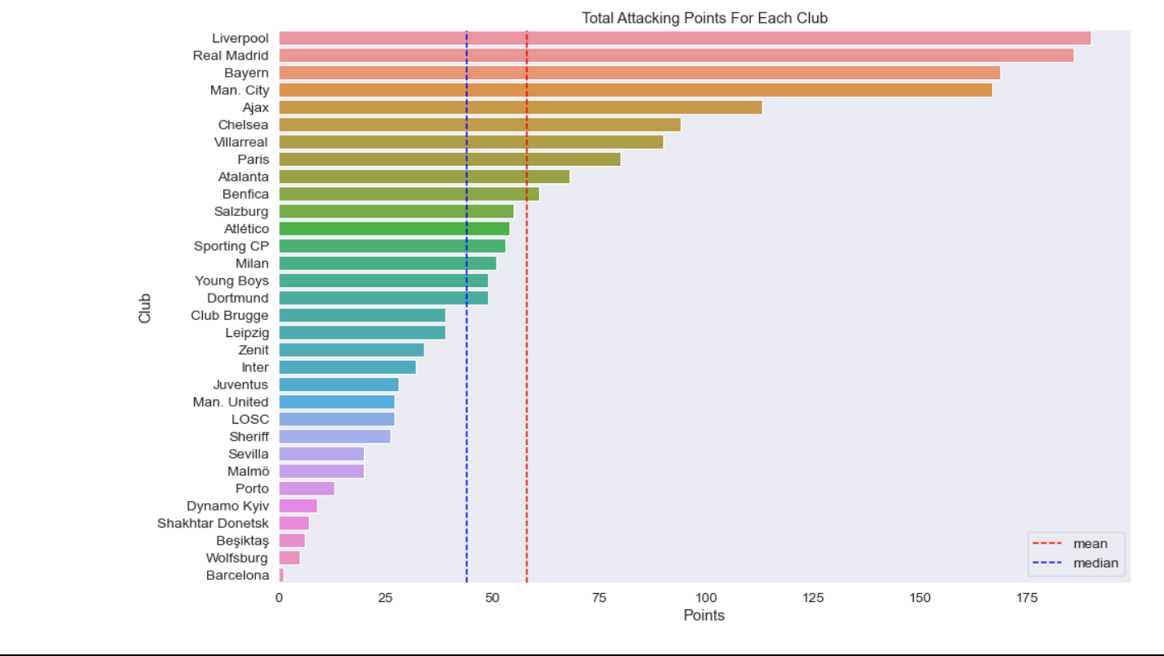
CLUB ATTACKING POINTS
Liverpool leads by attacking points
Mean is around 58
Median is around 46

Slide 7
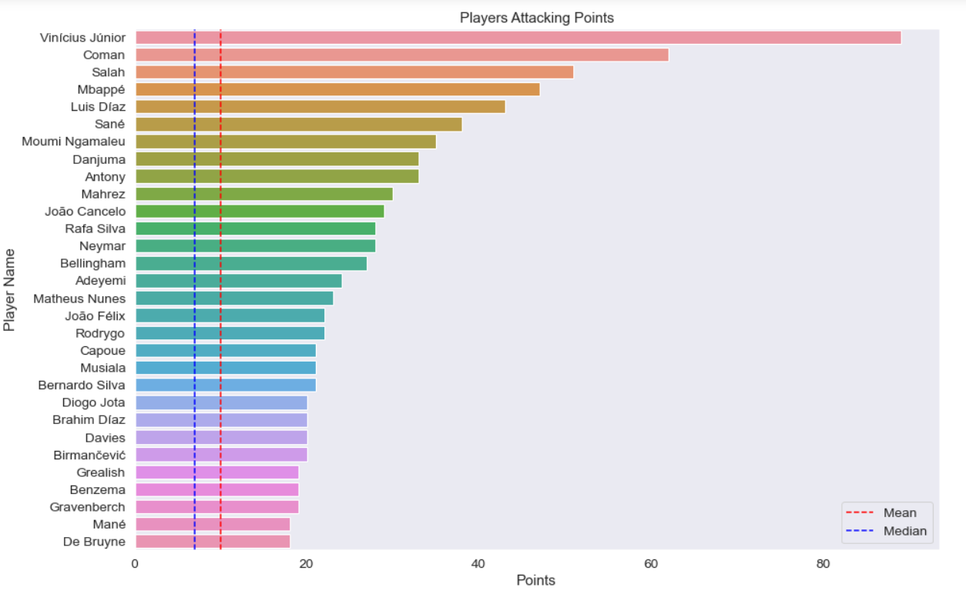
PLAYER ATTACKING POINTS
Vinicius Junior was the best attacker
Mean of all attackers is around 12
Median is around 10

Slide 8
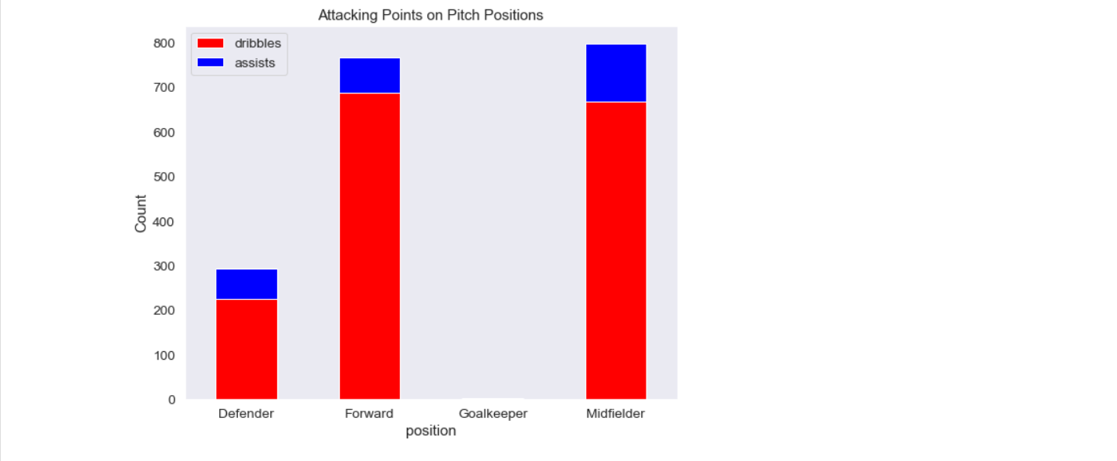
PLAYER POSITION ATTACKING POINTS
Midfielders had the most assists
Forwards had the most dribbles

Slide 9
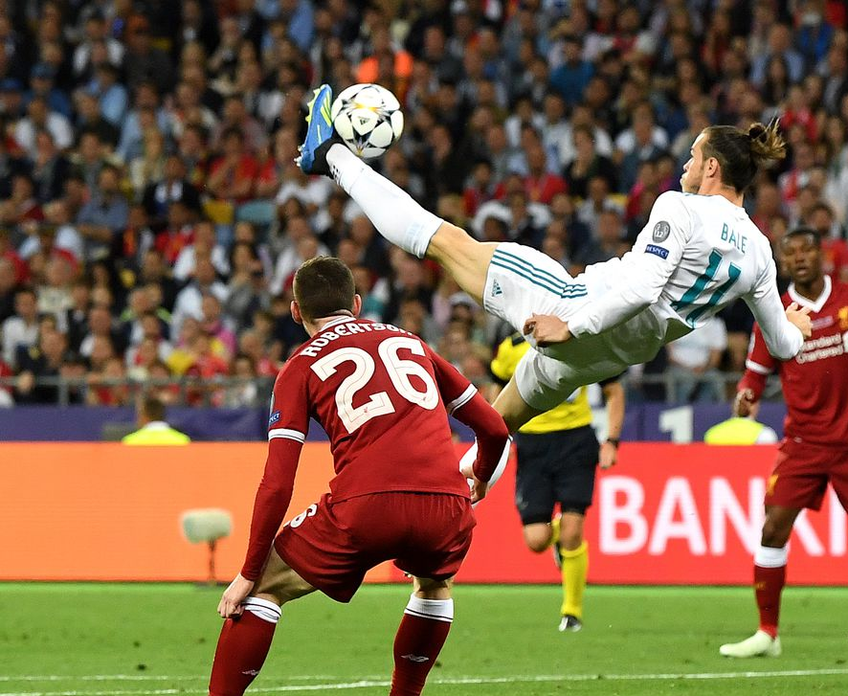
ATTEMPTS DATAFRAME
Attempts features and points for UCL 21/22

Slide 10
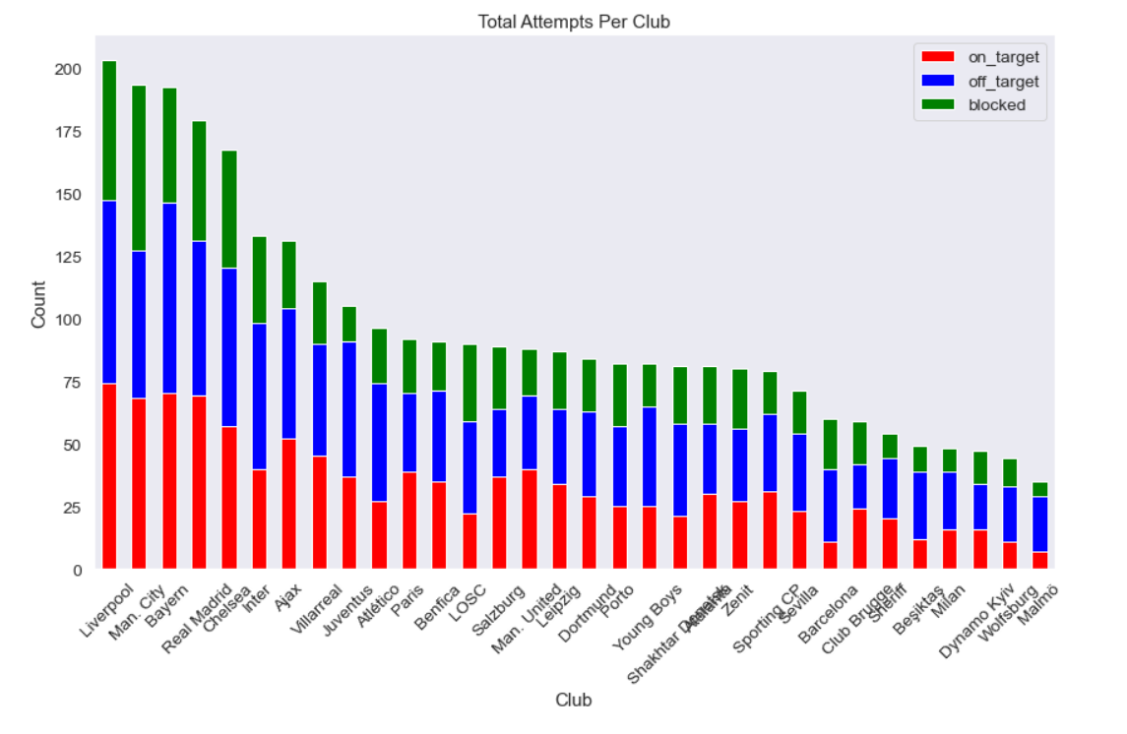
CLUB ATTEMPTS
Liverpool had the most attempts both on target, off target and blocked

Slide 11
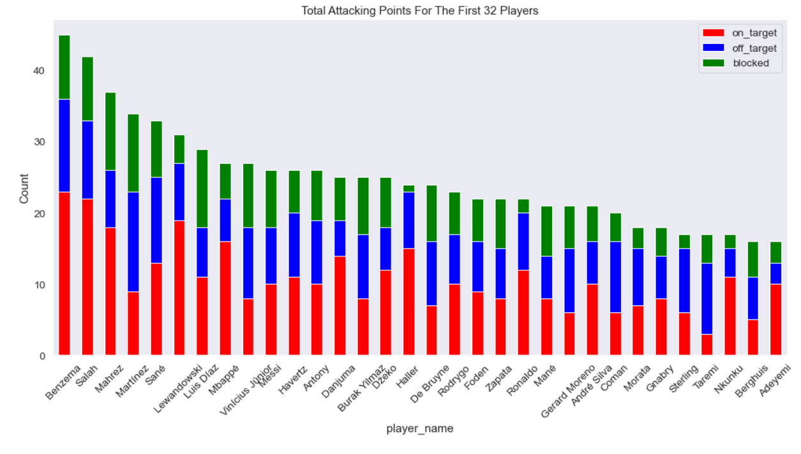
PLAYER ATTEMPTS
Karim Benzema had the most attempts both on target, off target and blocked

Slide 12
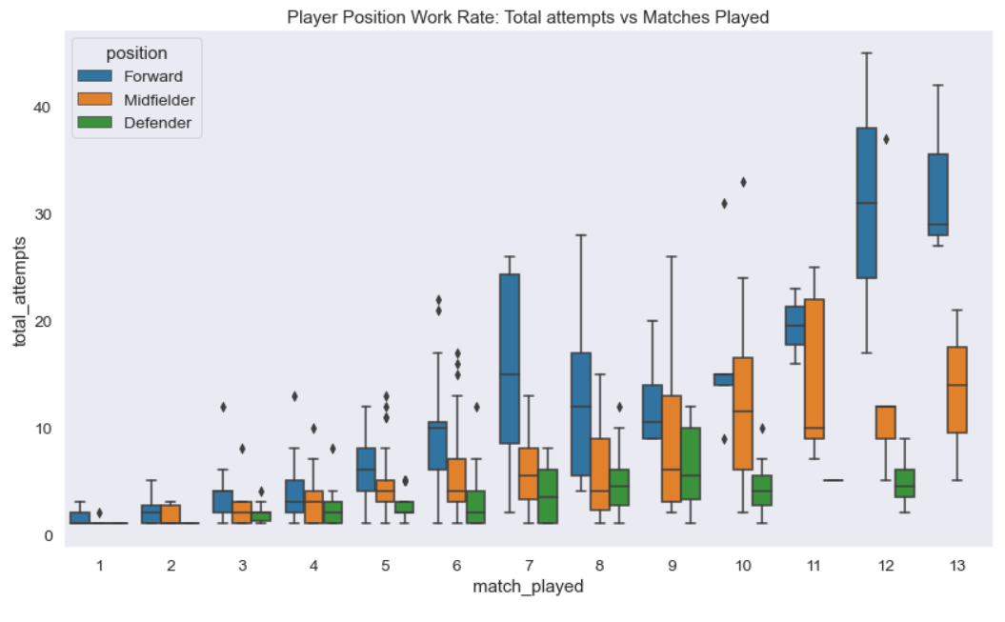
PLAYER POSITION WORK RATE
Forwards had the high attempts to match played ratio

Slide 13
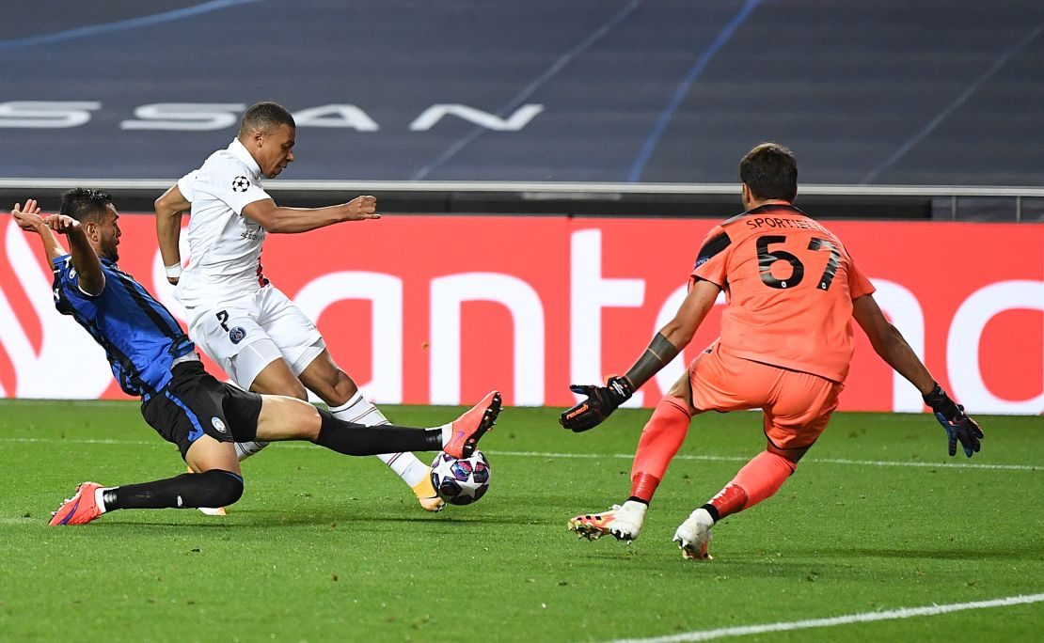
DEFENDING DATAFRAME
Defending attributes and points for the UCL 21/22

Slide 14
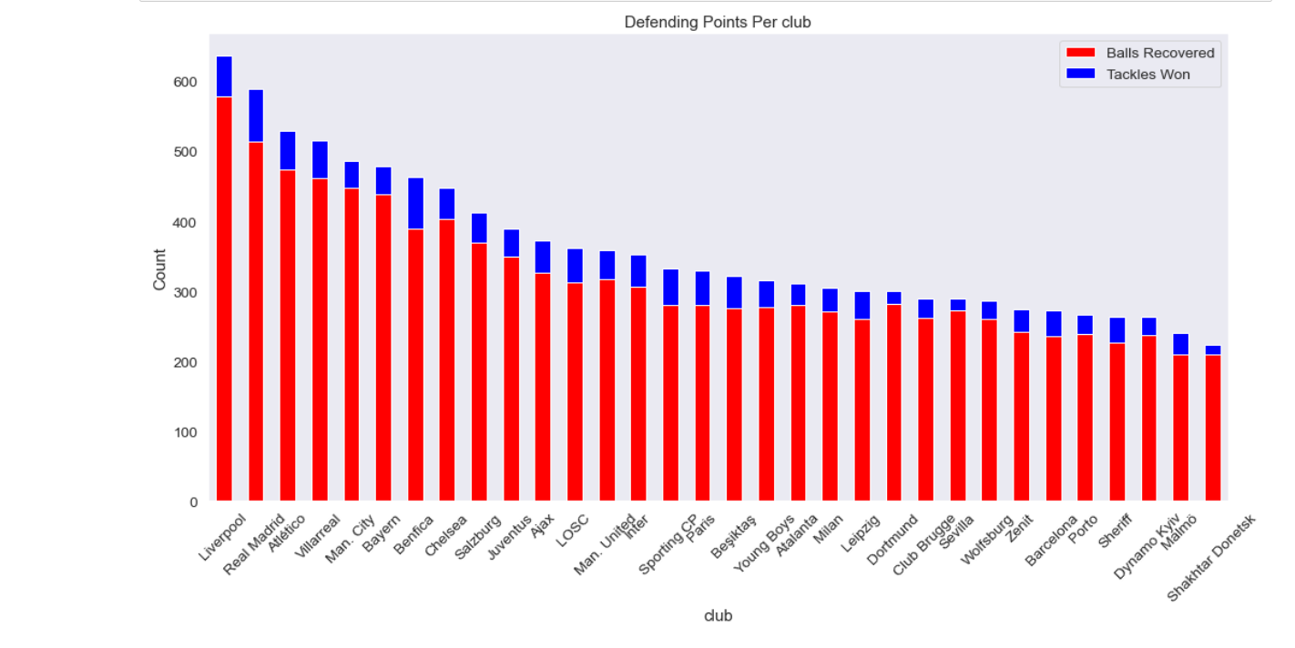
CLUB POINTS
Liverpool had the highest defending points.
Most Balls recovered and tackles won

Slide 15
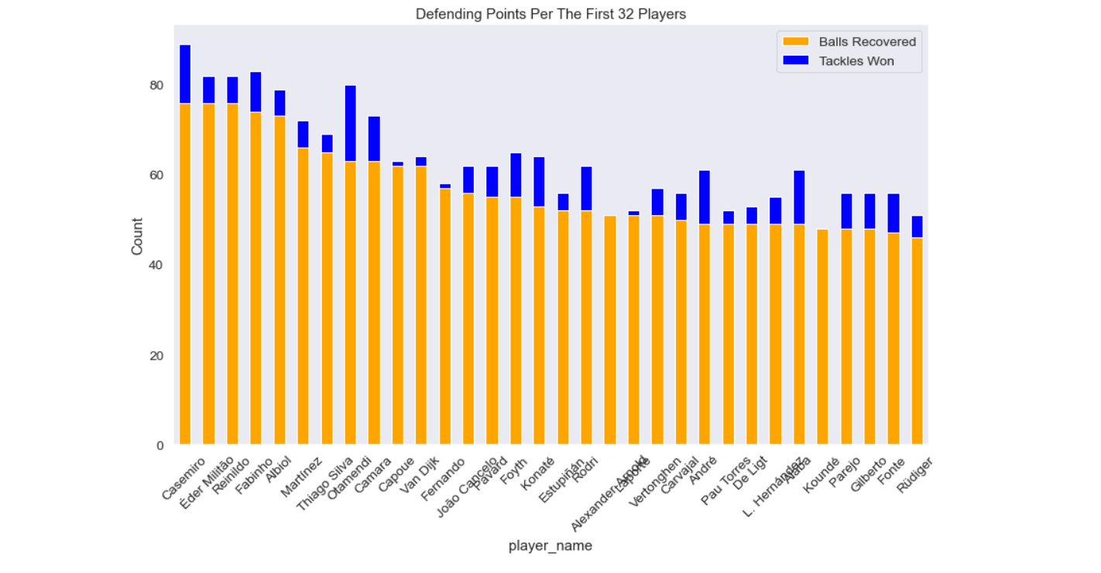
PLAYERS POINTS
Casemiro was the best defender having most balls recovered and tackles won

Slide 16
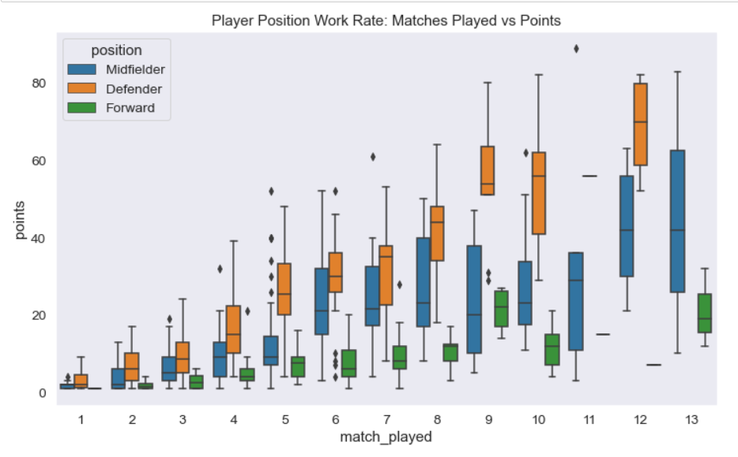
PLAYER POSITION WORK RATE
As expected, defenders had the highest defending points to match played ratio

Slide 17
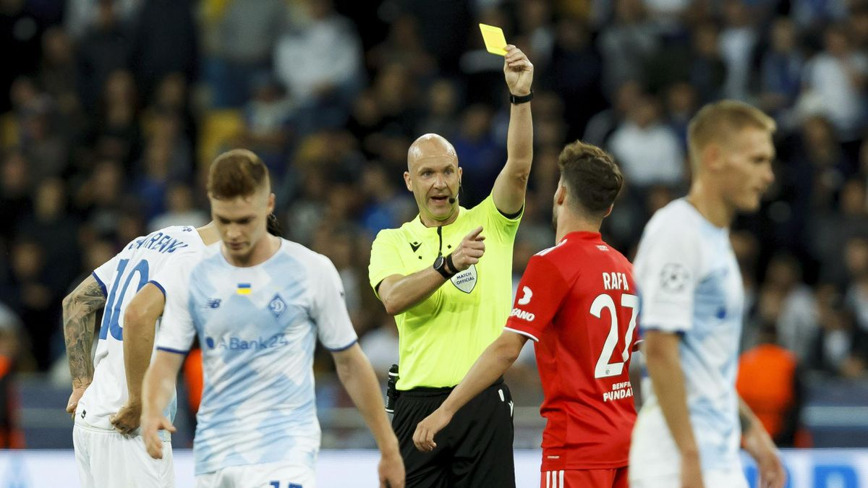
DISCIPLINARY DATAFRAME
Disciplinary points for the UCL 21/22

Slide 18
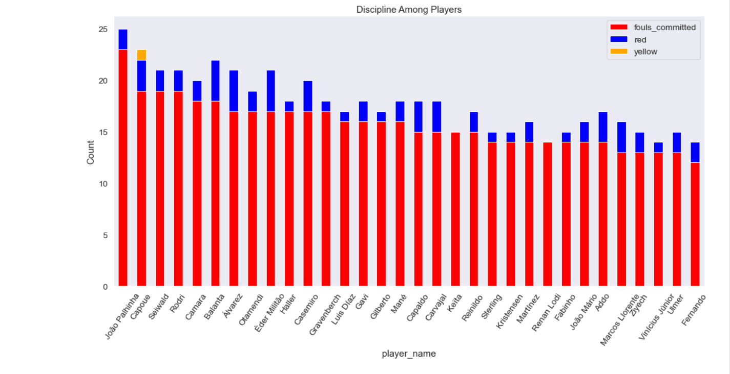
PLAYERS DISCIPLINE
Joao Palhinha was the most indiscipline having committed the most fouls.

Slide 19
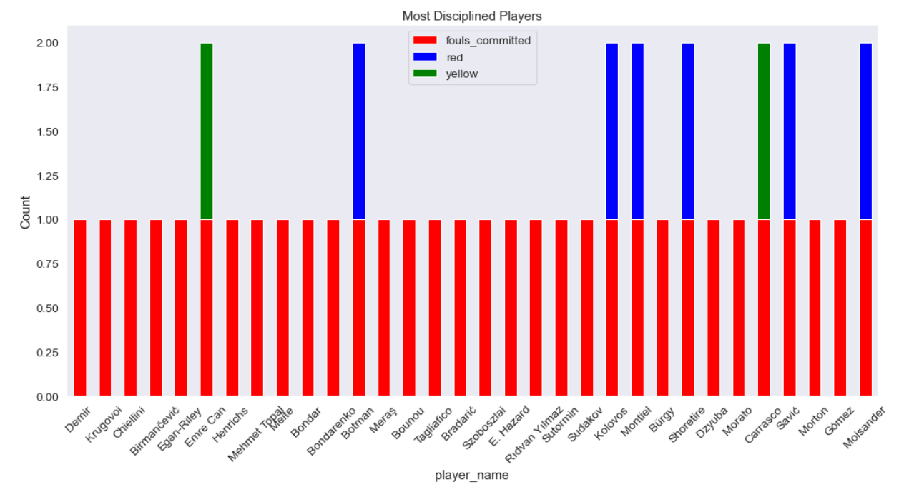
MOST DISCIPLINED PLAYERS
Demir was the most disciplined player having the least fouls committed and no cards given

Slide 20
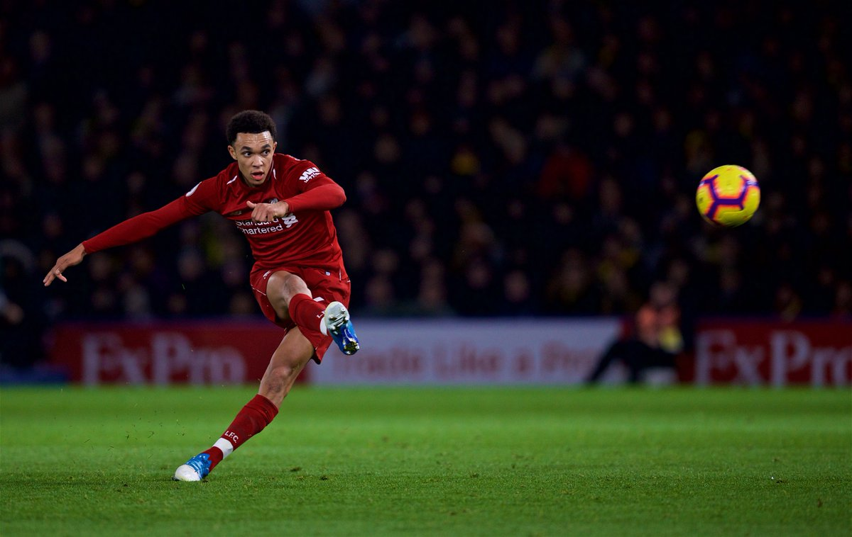
DISTRIBUTION DATARAME
Distribution points for the UCL 21/22

Slide 21
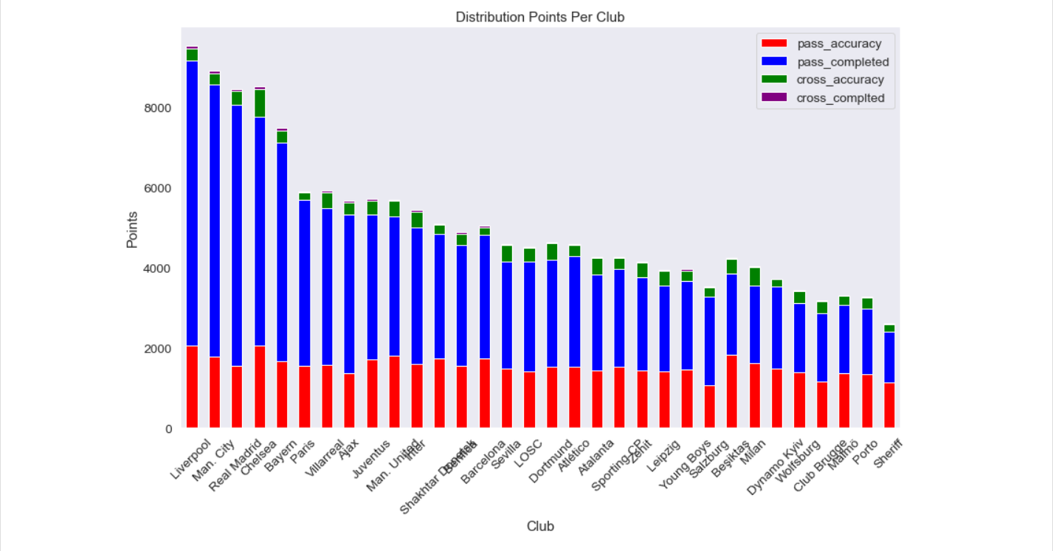
CLUB POINTS
Liverpool had the most passes completed.
Chelsea had the highest pass accuracy

Slide 22
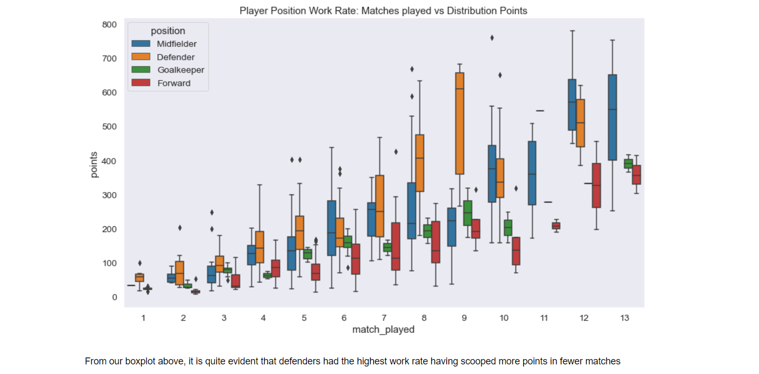
PLAYER POSITION WORK RATE
Defenders generally had a higher work rate since they had a higher points to match played ratio as seen on our boxplot.

Slide 23
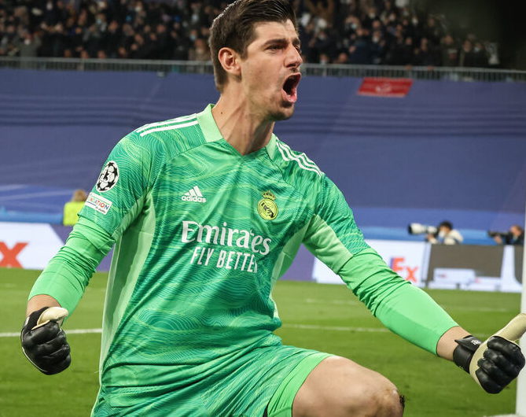
GOALKEEPING DATAFRAME
Goalkeeping performances for the UCL 21/22

Slide 24
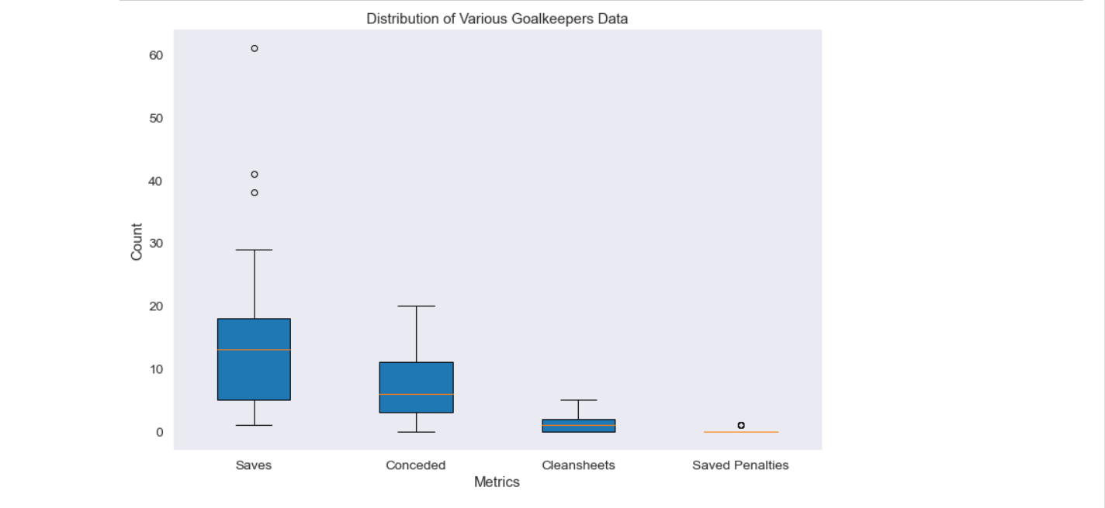
VARIOUS GOALKEEPER DATA
As seen from our boxplot, saves were the most in the UCL 21/22

Slide 25
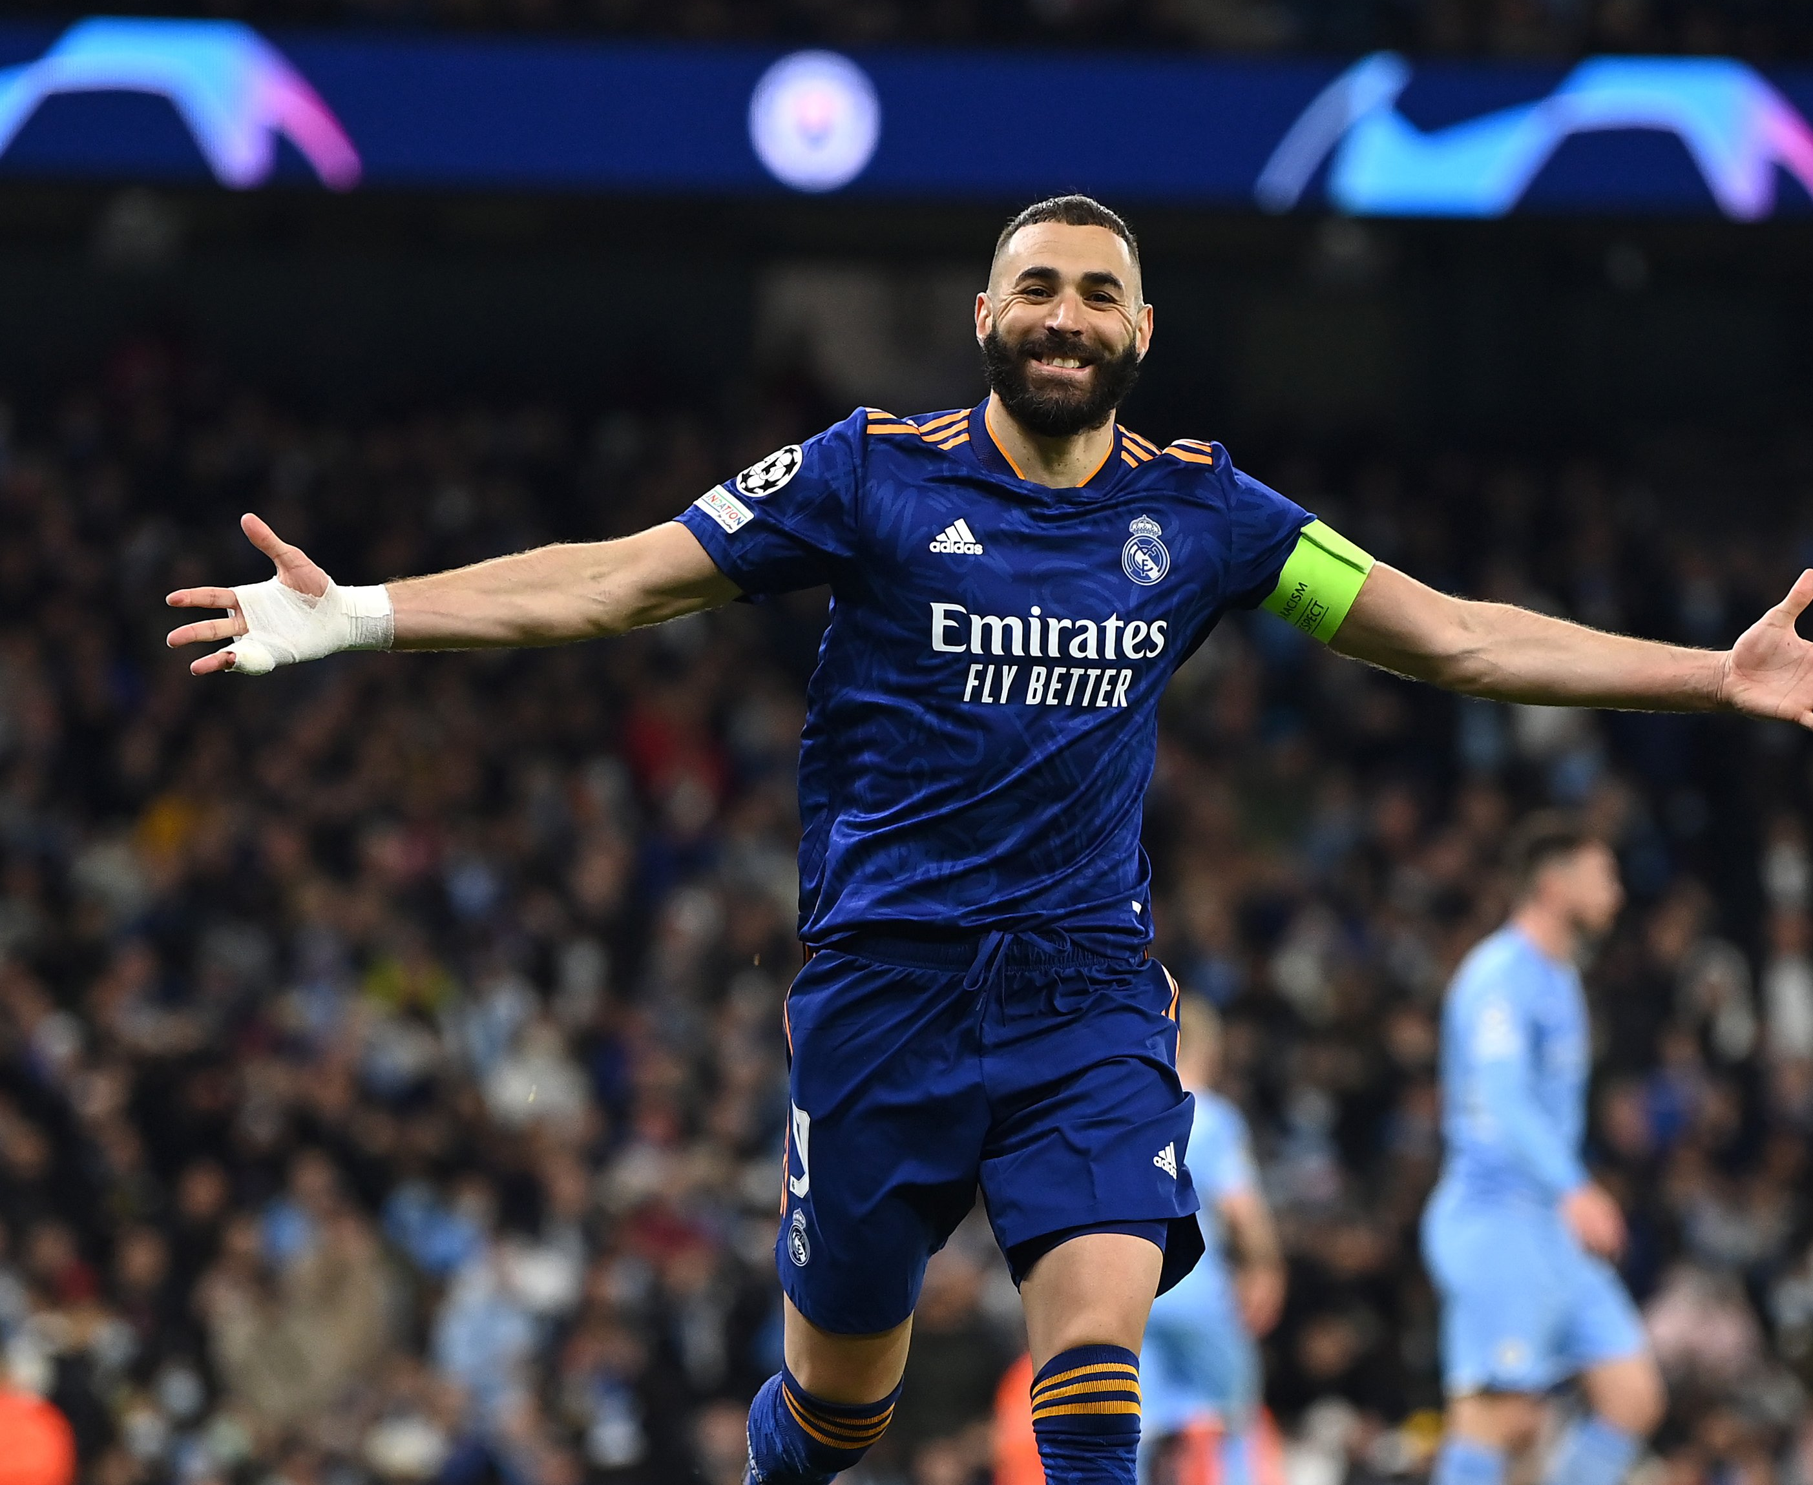
GOALS DATAFRAME
Goals in the UCL 21/22

Slide 26
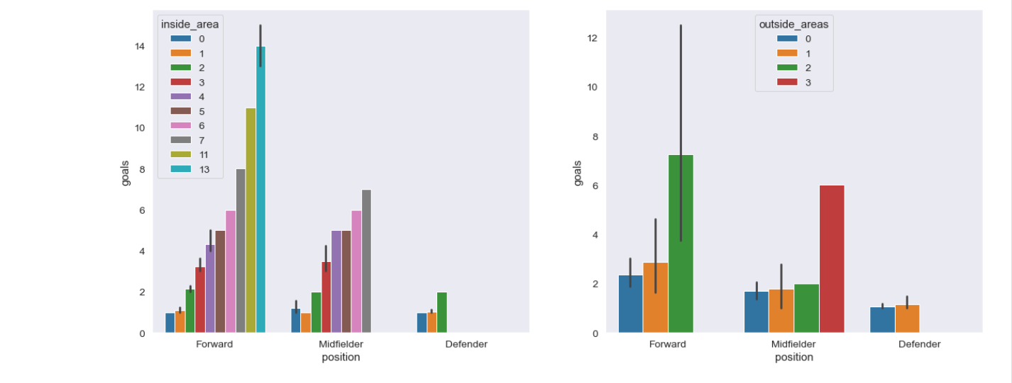
PITCH AREA GOALS
Most goals in the UCL were scored in the inside area.
As expected, most goals were scored by forwards

Slide 27
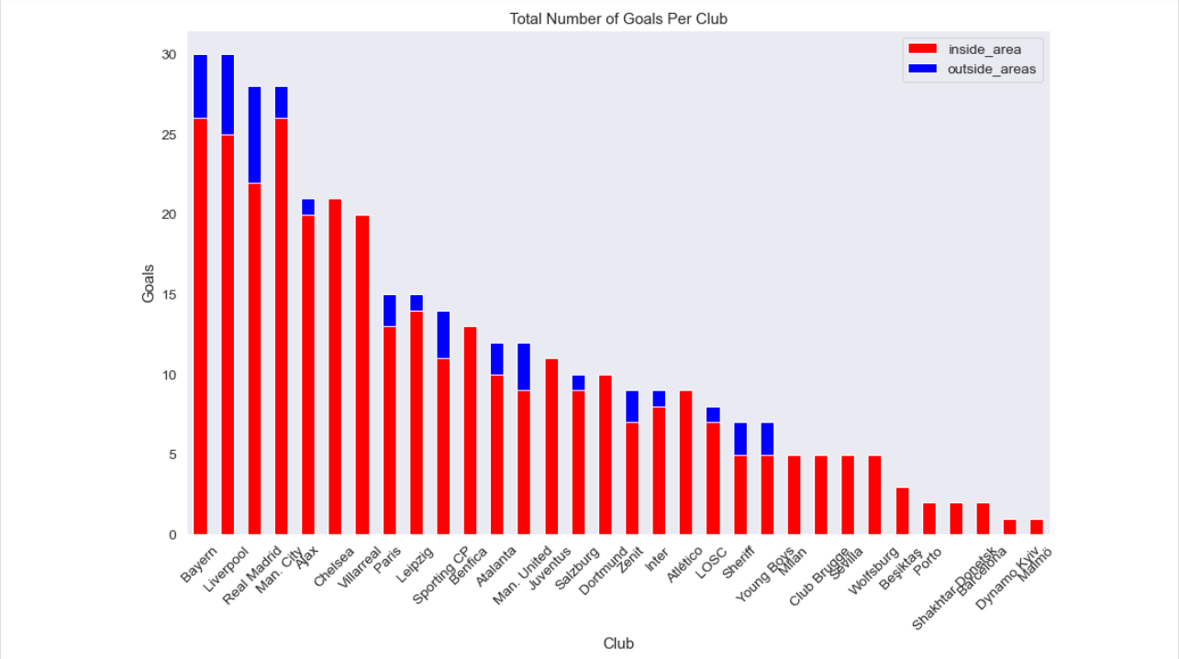
CLUB GOALS
Bayern and Liverpool had the highest number of goals.
Bayern had the most goals in the inside area.
Liverpool had the most goals in the outside areas

Slide 28
STATS DATAFRAME

Slide 29
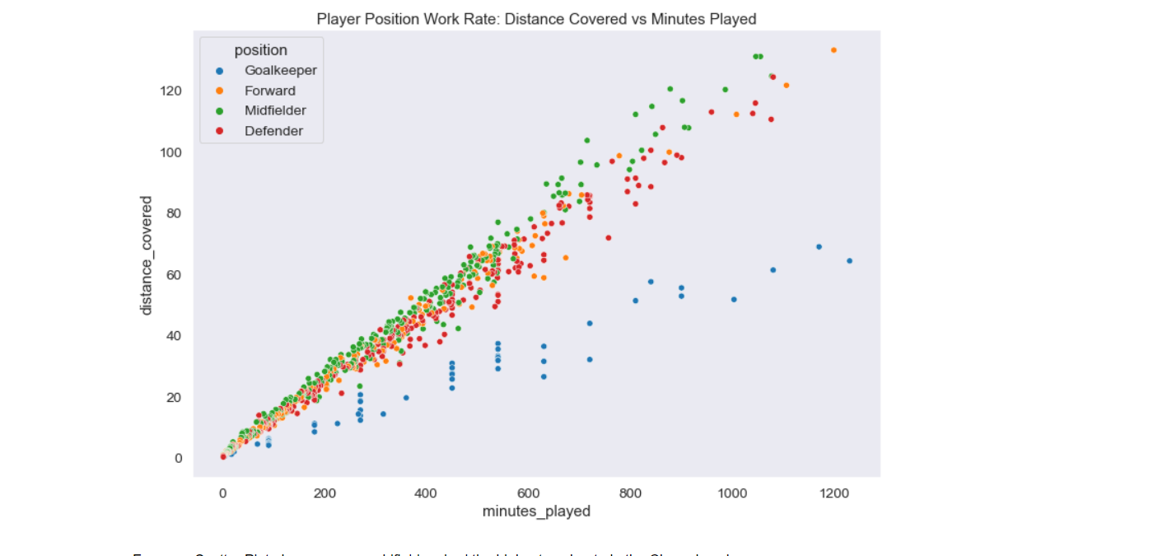
PLAYER POSITION WORK RATE
Midfielders had the highest work rate

Slide 30

WINNERSIUCL 21/22
REAL MADRID

Slide 31
UCL SINCE 1980

Slide 32
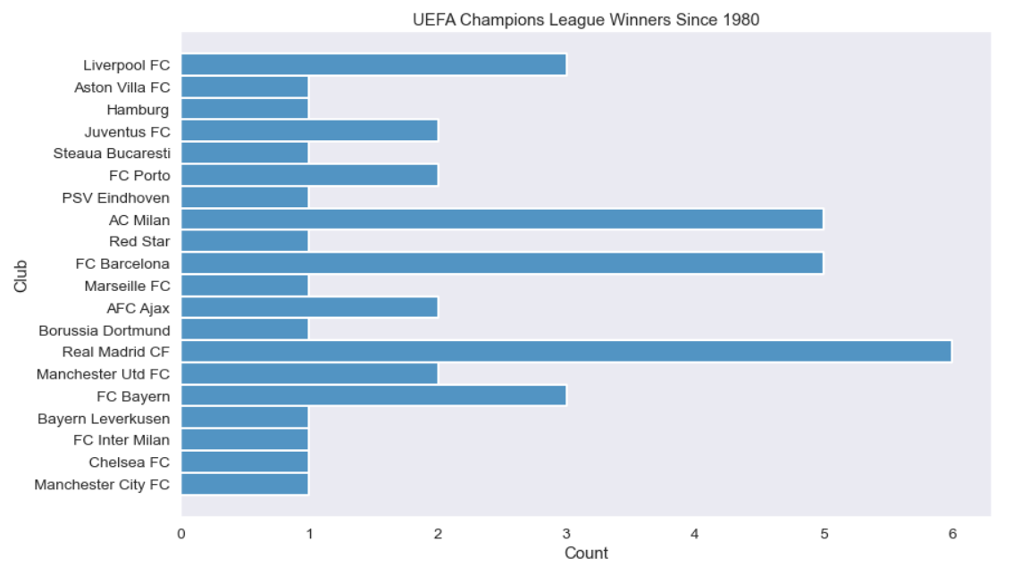
CHAMPIONS LEAGUE WINNERS SINCE 1980
Real Madrid have won the most titles

Slide 33
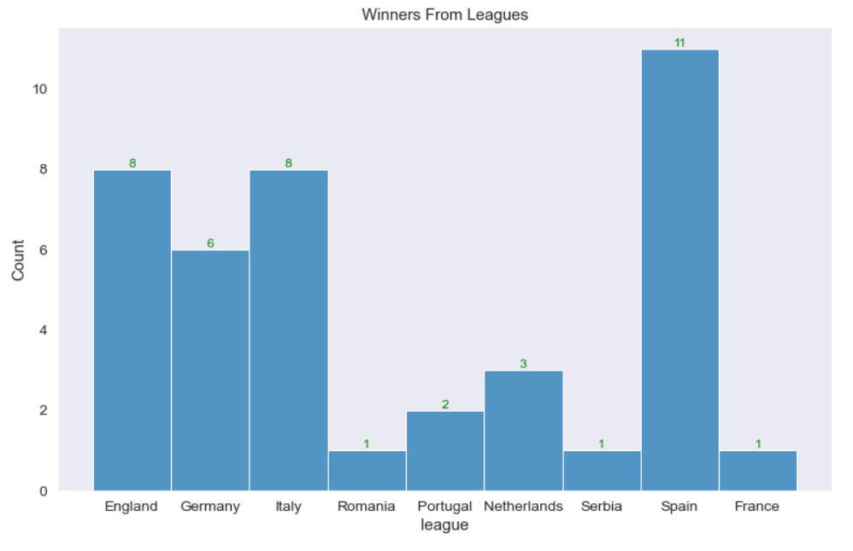
WINNERS FROM LEAGUES
Spain has produced the most winners.

Slide 34
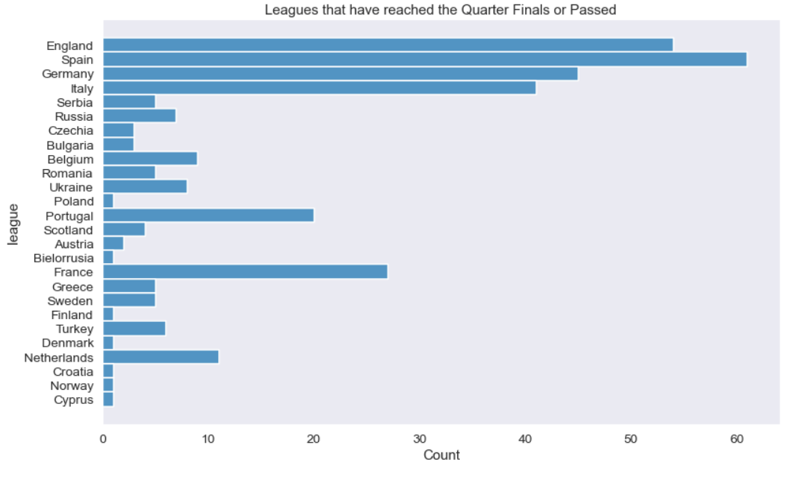
MOST QUALIFIED LEAGUES
Spain is the most qualified league/country in the UCL.

Slide 35
THANKYOU SLIDE
Thankyou for your time. I hope you learnt something about the UCL and enjoyed the process while at it.

